Slide 1
Scrum-agile
Is the time right?
Brandon Hobbs
CS 250
12/9/2021

Slide 2
Scrum-agile Roles
How would the team be “re-organized”

Slide 3
Scrum-agile Team Roles: Product Owner
Product Owner
Acts to represent the business sponsor ¹
Accountable for maximizing the value of the Team’s work ³
Accountable for effective backlog management ³
Clear expression of the backlog items; ensuring development understands ¹
Ordering items to achieve goals and mission ¹
Ensuring backlog is visible and transparent ¹
Shows what the team will work on next ¹

Slide 4
Scrum-agile Team Roles: Developers
Developers
Are committed to creating a usable component each Sprint ³
Accountable for:
Planning the Sprint and the Sprint Backlog ³
Instilling quality by adhering to a Definition of Done ³
Adapting their plan, daily, toward the Sprint Goal ³
Holding each other accountable as professionals ³
Maintaining all the skills necessary to create product ¹
Not creating sub teams ¹
Self organizing – no one tells them how to turn the backlog into functionality ¹

Slide 5
Scrum-agile Team Roles: Scrum Master
Scrum Master:
Accountable for performing Scrum as defined in the Scrum Guide ³
Accountable for the Scrum Team’s effectiveness ³
Acts as a servant leader ¹ who serve the Scrum Team and the larger organization ³
Coach the team members in self-management and cross-functionality ³
Help creating high-value work that meet the Definition of Done ³
Remove impediments to the team’s progress or barriers between stakeholders and teams ³
Ensure all Scrum events take place and are positive, productive, and timeboxed ³
Help find effective techniques for Product Goal definition and Product Backlog management ³
Help the PO understand the need for clear and concise backlog items ³
Help establish product planning for a complex environment ³
Facilitate stakeholder collaboration as needed or requested ³
Lead, train, and coach the organization in its Scrum adoption ³
Plan and advise Scrum implementations within the organization ³
Should not provide significant direction as team is self organizing ¹

Slide 6
Process changes: new SDLC
Scrum-agile workflow

Slide 7
Phases of the Software Development: Classical View
Requirements Gathering
Software Design
Software Development
Test and Integration
Deployment
Operationalization and Maintenance

Slide 8
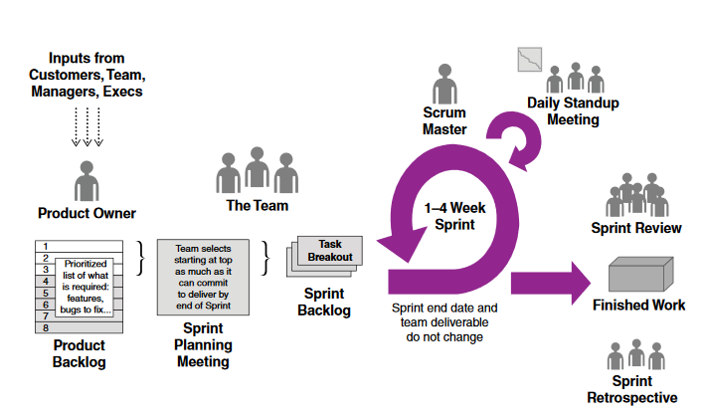
Phases of the Software Development: Agile View
Requirements Gathering
Implementation is begun before understanding is finalized
Elaboration of requirements and user stories is progressive
Software Design/Development
Iterative
Product should be left “working” at the end of an iteration
Uses 5 cyclical phases
Sprint
Sprint Planning
Daily Scrum
Sprint Review
Sprint Retrospective
No sub teams, i.e., there is no independent testing team or testing phase
Deployment
Iterative over the course of the project, i.e., deployment/feedback is continual and not the final phase

Slide 9
An example: SNHU Travel Project
Under waterfall
Under Agile
Top 5 list instead of slideshow should have been understood before coding started
If changed too late in process, i.e., ready to test, could have resulted in delay
Full elaboration and planning would have occurred before coding started
Project plan would have been fully elaborated
Project might have been delayed while deciding on Jira and AWS
Testing phase would have occurred as a capstone – just prior to delivery
Any critical bug might have delayed delivery
Any failed requirements might have delayed delivery
Top 5 slideshow was treated as a pivot based on feedback
Work items updated
Process absorbed the change
Project started as soon as a Minimum Viable Product was defined
Jira decided mid-project and work was transferred
AWS decision was also mid-cycle and absorbed
Testing was incorporated into the sprint
Bugs closed iteratively and test cases updated
Requirements, User Stories, tasks updated progressively

Slide 10
Are we ready?
Decision Time

Slide 11
Factors to Consider When Choosing Waterfall or Agile Approach
If the company and culture are ready: ²
Evangelists available to create good practices and correct poor practices
Stakeholders must be available for review sessions, if not customers themselves
Marketing and Sales need to reduce their reliance on a predictable feature-based roadmap
Management and Executives need to understand Agile is a priority-driven “pull” model and not an opinion-driven “push” model
How stable is the team:
Turnover can hamper adoption and produce bad habits
Instability can hamper the ability to improve estimation during Sprint planning

Slide 12
Factors to Consider When Choosing Waterfall or Agile Approach
How detailed and well-understood are the project goals and requirements:
Choose waterfall if: ²
Requirements are already complete and Well understood
Plan can Be defined prior to implementation
Culture is not aligned, top to bottom, with idea of change
Choose agile if: ²
Ability to accept that not everything is known about the plan
If requirements and understanding is to evolve
If there is flexibility to release features progressively
organizational Culture is ready to change and align with new process

Slide 13
References
Charles G. Cobb. (2015). The Project Manager’s Guide to Mastering Agile: Principles and Practices for an Adaptive Approach. Wiley.
Gilley, C. (n.d.). The Pros and Cons of Agile Product Development. User Voice. Retrieved Nov. 28, 2021, from https://www.uservoice.com/blog/the-pros-and-cons-of-agile- product- development
Schwaber, K., & Sutherland, J., (2006). The Scrum Guide. [White Paper]. Scrum Guides. https://scrumguides.org/docs/scrumguide /v2020/2020-Scrum Guide-US.pdf#zoom=100

